Slide 1

Analysis of Fish Guidance Structures in downstream migration
Group 9: Beck, Elliot; Fuentes, Eufemiano; Park, Jun

Slide 2
Index
Introduction to the topic
The problem (what the client wants)
How we plan to solve the problem
Discussion

Slide 3
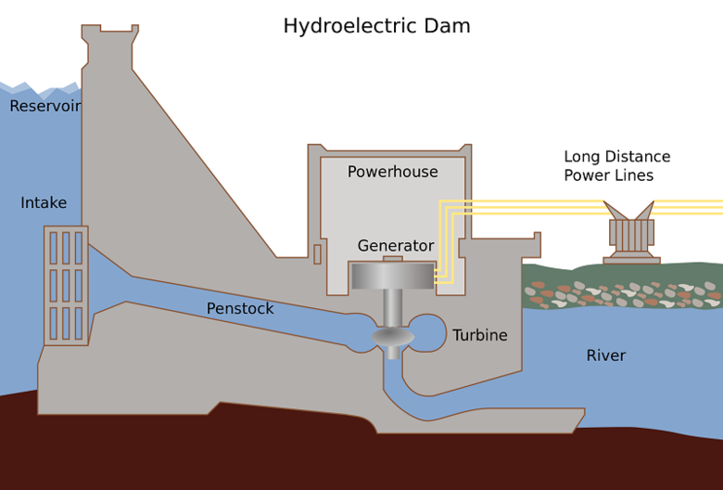
1. Introduction to the topic
What are Fish Guidance Structures?

Slide 4
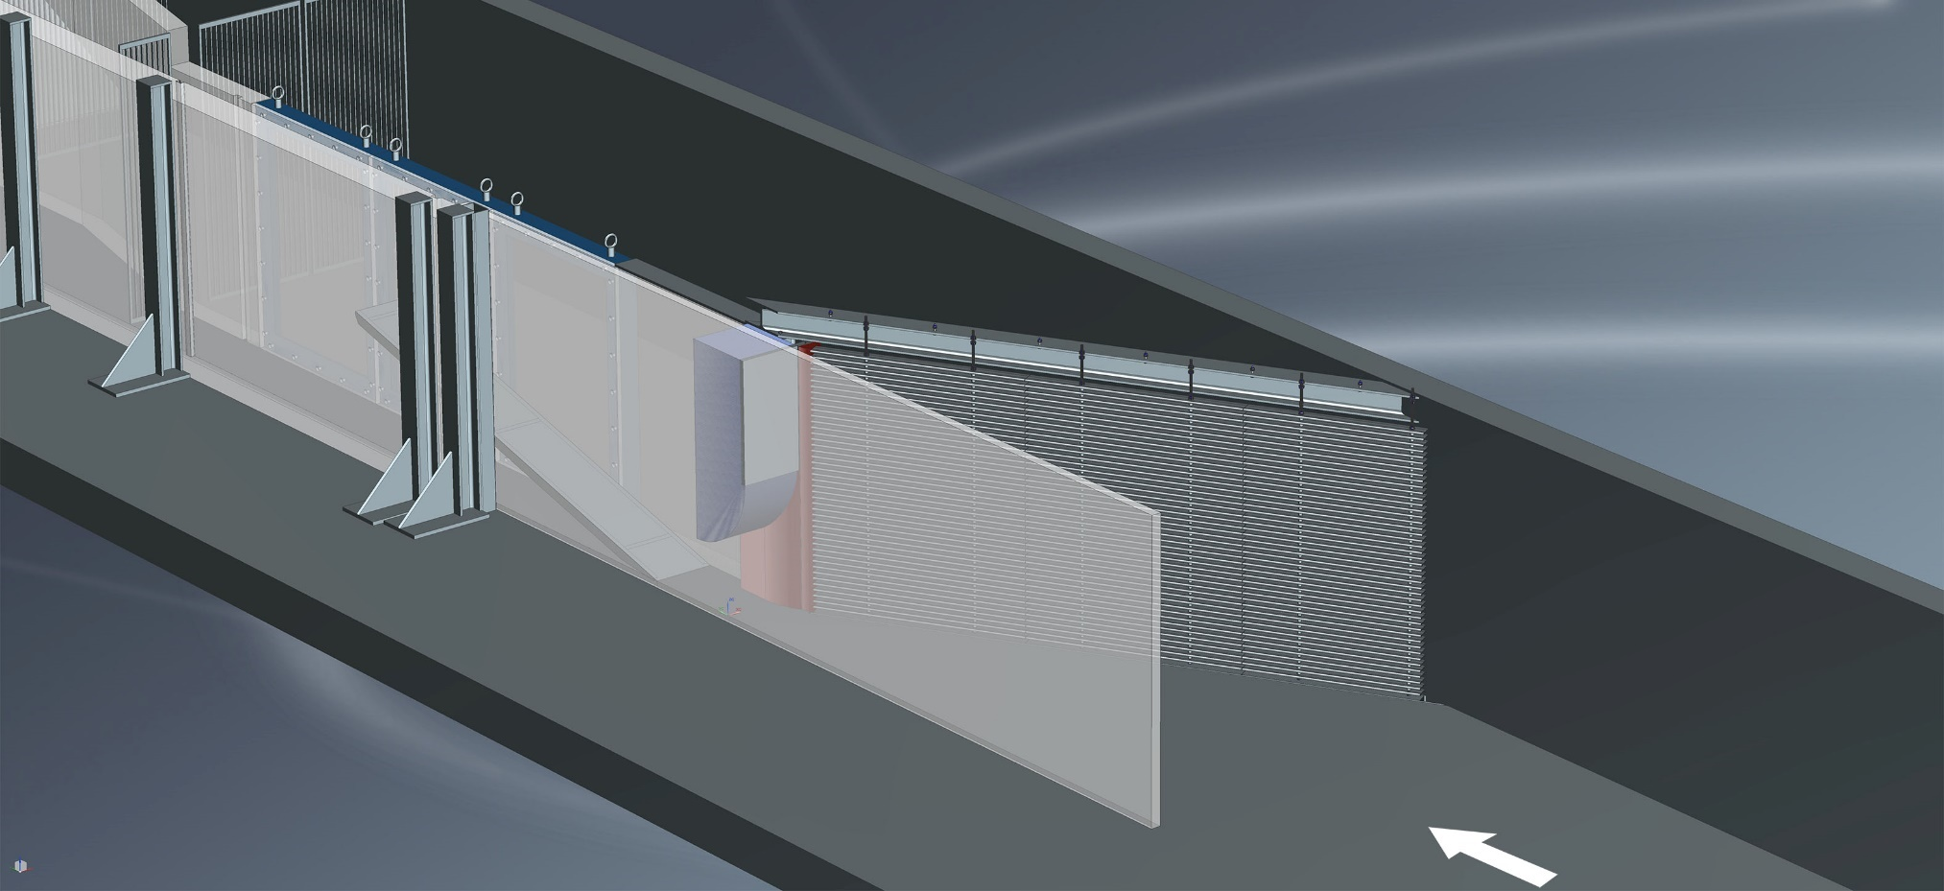
1. Introduction to the topic
What are Fish Guidance Structures?

Slide 5
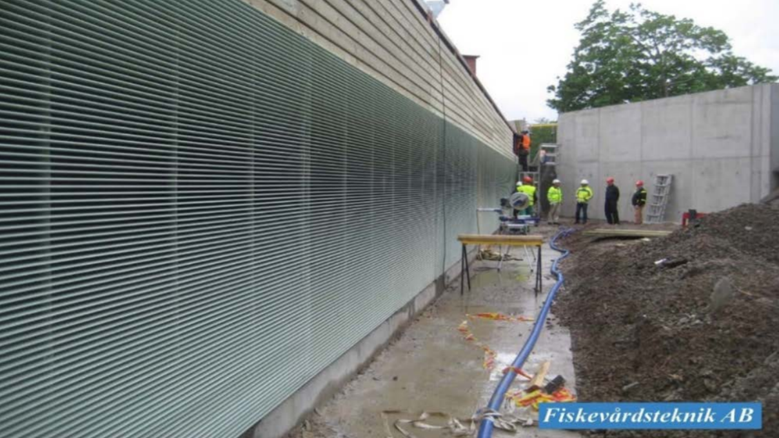
1. Introduction to the topic
What are Fish Guidance Structures?

Slide 6
1. Introduction to the topic
The clients are 2 PhD students at ETHZ D-BAUG
They want to conduct an experiment, they don’t have any data yet.
They want to quantify the fish guidance efficiency for different rack and bypass configurations.
Three possible outcomes:
The fish swims through the bypass (success)
The fish swims through the guidance structure (failure)
The fish refuses to swim through the bypass or the structure (failure)

Slide 7
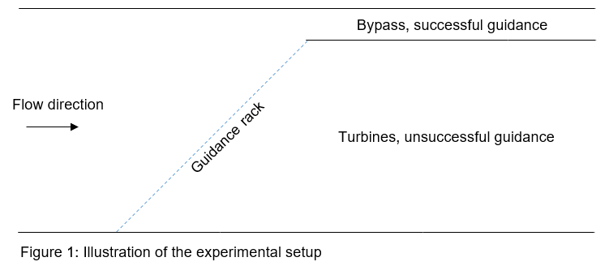
1. Introduction to the topic

Slide 8
1. Introduction to the topic
How will the experiment be conducted?
2 different guidance structures (vertical and horizontal)
3 different bypass configurations
In total 6 possible configurations
Maximum of 3 fish simultaneously
When and where will the experiment take place?
Autumn 2018 and Spring 2019
Laboratory of Hydraulics, Hydrology and Glaciology (ETH Hönggerberg)

Slide 9
2. The problem
Live-fish experiments are extremely time consuming
Objective: to obtain the smallest number of fish (sample size) such that the results are significant
Tradeoffs
The higher the precision to detect differences, the larger the required sample size
The more parameters included in the model, the larger the required sample size

Slide 10

2. The problem
Lots of parameters can affect the efficiency
Flow conditions
Light conditions
Water temperature
Etc.
Natural schooling behaviour of fish
A biologist decides how many fish must go together
Only 3 fish can be released together simultaneously
Need to include a control treatment, but status quo is unknown

Slide 11
3. How we plan to solve the problem
Consider different models
Mixed-Effects models, Bayesian models, Logistic Regression, …
Place assumptions on the parameter values
Run simulations
Compute required sample sizes for given power
Present to the clients different models with their corresponding required sample sizes

Slide 12
4. Discussion
What models do you think we could use?
Would you model the schooling behaviour as a random effect or as a proportion observation?
Do you have additional comments/ideas?

Slide 13
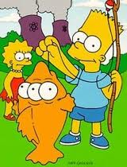
Thanks for your attention!

